Slide 1
Mean-Variance Portfolio Rebalancing with Transaction Costs
FIN 500R
Author: Philip H. Dybvig
Speaker: Yueying Li

Slide 2
CONTENTS
Introduction
01
Numerical Results
02
Theory: Single Risky Asset Example
03
Conclusion
04
My Opinion
05

Slide 3
Introduction
Background | Mean-Variance Analysis

Slide 4
1.Background
Optimal portfolio rebalancing given transaction costs is a complex problem.
Two assets free boundary problem
More securities only in extreme case with some constraints
This article: single-period rebalancing problem in a mean-variance framework that permits exact solutions.

Slide 5
2.Mean-variance analysis
Early discussions of transaction costs
Focus on the intuition that small investors who face high costs will choose a smaller and less diversified portfolio than will a large investor with small costs.
Messy combinatoric problem looking at all possible subsets to include
Static perspective does not suited to questions about rebalancing.

Slide 6
2.Mean-variance analysis
Current Analysis
Two differences:
i.Considering rebalancing from any starting portfolio rather than from scratch
ii.Focusing primarily on variable costs rather than fixed costs
Closer to the continuous models we should ideally be using

Slide 7
Numerical Results
Variable Cost | Futures Overlay | Bundles Trading | Overall Fixed Costs
| Security-Specific Fixed Costs

Slide 8
Variable Cost (λ = 2,κ = 0,corr = 0.5)
With proportional costs, the non-trading region is a parallelogram.
Outside the non-trading region, it is optimal to trade along the blue arrows to the boundary of the non-trading region.
Correlated -> the two securities are substitutes. Over-weighting in one security is less likely to result in a trade if we are under-weighted in the other security.
Uncorrelated, then the non-trading region would be a square with sides parallel to the axes.

Slide 9
Variable Cost (λ = 2,κ = 1,corr = 0.5)
With penalty for deviations from a benchmark, the non-trading region shrinks and moves towards the benchmark (Security 1: 40%, Security 2: 20%).
Putting a penalty on deviations from a benchmark would not happen in an ideal world, but may improve incentives or coordination for managers and are common in practice.

Slide 10
Variable Cost (C₁ = 0.02,C₂=0.04)
Cost of trading↑ non-trading region↑
C₂ > C₁, so the vertical size of the non-trading region is large.
Starting with all cash (at the “×”), the optimal trade forgoes the expensive Security 2 and purchases only Security 1 (along the green arrow)

Slide 11
2.Futures Overlay
One popular example of a transaction-cost-aware strategy is to use futures as an inexpensive way of keeping effective asset allocation in line with a benchmark or ideal allocation.
Maintaining a weighting near the ideal weighting by trading equities is very expensive. A futures overlay might correct for minor deviations from the ideal weighting by trading in futures, which are highly correlated with equities but much cheaper to trade.
An improvement on the traditional form of the strategy.
Expected return (“alphas”) -> very important!

Slide 12
Futures Overlay (µ1≈µ2, corr = 0.942809)
Security 1: Equity
Security 2: Futures
Equity-equivalent mean returns µ_{i} are nearly the same & highly correlated.
It is optimal to pursue a “synthetic equity” strategy.
Starting from all cash (the “x”) -> buy futures only.

Slide 13
Futures Overlay (µ1>µ2, corr = 0.942809)
µ1>µ2: active management, cost of rolling the futures, tax-timing advantages
Trade-off -> asymmetric “futures overlay” strategy
Selling futures -> correct for overexposure to market risk and keep the alpha on the exposure we are eliminating
Buying underlying equities -> correct for underexposure to market risk and gain alpha on the exposure we are taking on

Slide 14
3.Bundles Trading
Purchasing a bundle of securities is more cheaply than its constituent securities.
New sides of the non-trading boundary

Slide 15
Bundles Trading
An additional opportunity to trade a portfolio of the two assets at a cost of .0035
Corners: trade the bundle and one of the securities
More securities -> More complex
Simultaneous buys and sells of different individual securities

Slide 16
4.Overall Fixed Costs
If we trade, the cost is the same whatever trade we make
We always trade to the same ideal portfolio
Comparing the utility of not trading with the utility of trading to the ideal point but incurring the fixed cost
The size of the trading region is proportional to the square root of the trading cost, since the utility loss in any direction is proportional to the squared distance from the optimum

Slide 17
Overall Fixed Costs
The non-trading region (shaded yellow) is an ellipse.
Either there is trade immediately to the ideal point (indicated by “+”) or it is not worth trading at all
As with proportional costs, correlation between the assets implies that it is more damaging (and more likely to do trade) when both asset positions are out of line in the same direction
Uncorrelated -> circle

Slide 18
5.Security-Specific Fixed Costs
A fixed cost for each security
Comes from a due diligence requirement to monitor or document any security in the portfolio
A complex combinatorial problem, because each possible set of included portfolios gives a different piece of the overall non-concave objective function
Different starting portfolios will cause us to trade to different target portfolios

Slide 19
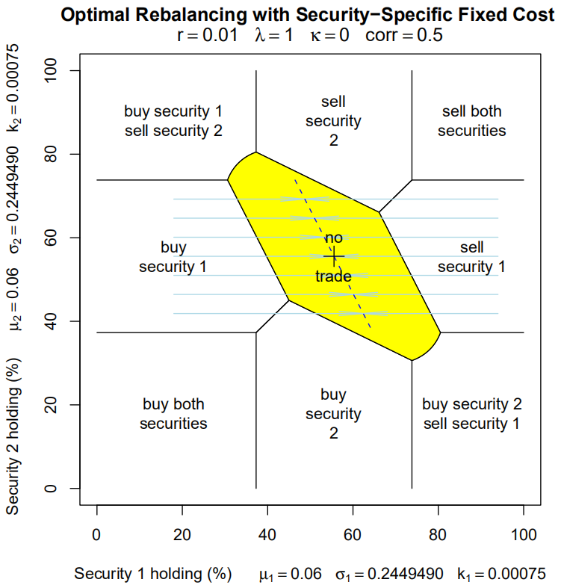
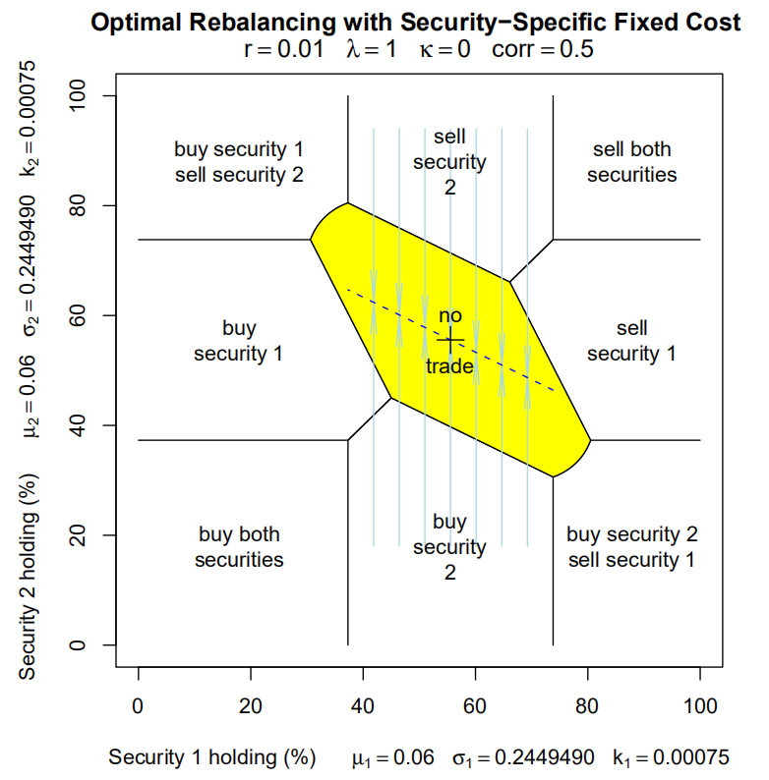
Security-Specific Fixed Costs
From the regions in the corner, we trade both securities to the ideal point.
From the regions on the right and left, we trade Security 1 but not Security 2 to a line going through the ideal point.
From the regions above and below, we trade only Security 2 to a different line running through the ideal point.

Slide 20
Theory: Single Risky Asset Example
Problem 1 | Problem 2

Slide 21
Problem 1 (proportional costs, single risky asset)
Choose purchases P ≥ 0 and sales S ≥ 0 of the risky asset to maximize the utility function:
Expected Return
Disutility of
Taking on Variance
Penalty for Tracking Error
Transaction
Costs

Slide 22
Problem 1 (proportional costs, single risky asset)
Solution: characterized by a non-trading region
It is always better to execute the net transaction

Slide 23
Problem 1 (proportional costs, single risky asset)
This single period model is different from typical continuous-time models.
1. In continuous-time models, the size of the non-trading region is more than proportional to costs when costs are small because we are not so urgent to trade.
2.At the optimum, the impact of transaction costs on optimal utility is of first-order in single-period model, which is different from traditional continuous-time models

Slide 24
Problem 2 (fixed cost, single risky asset)
Choose a quantity θ of the risky asset to maximize the utility function:
Expected Return
Disutility of
Taking on Variance
Penalty for Tracking Error
Transaction
Costs

Slide 25
Problem 2 (fixed cost, single risky asset)
Solution: characterized by a non-trading region
given that we are incurring the fixed cost, we may as well trade all the way to the ideal point θ star
Non-trading boundaries:

Slide 26
Conclusion
We have used a mean-variance analysis of portfolio rebalancing given transaction costs to illustrate a number of important economic features in a context that is simple to understand and solve completely. The single-period case is suggestive of good strategies in more realistic cases, and is a useful benchmark for comparisons

Slide 27
My Opinion
The graphical analysis is easy to understand
Can give us some intuition of the economics
The analysis in this article can accommodate multiple risky assets (eg. futures, swaps, stocks, etc.)
This analysis is more general mostly in that it does not assume the starting position in in cash alone
Suggestive for other more complex research

Slide 28
THANK YOU

